Slide 1
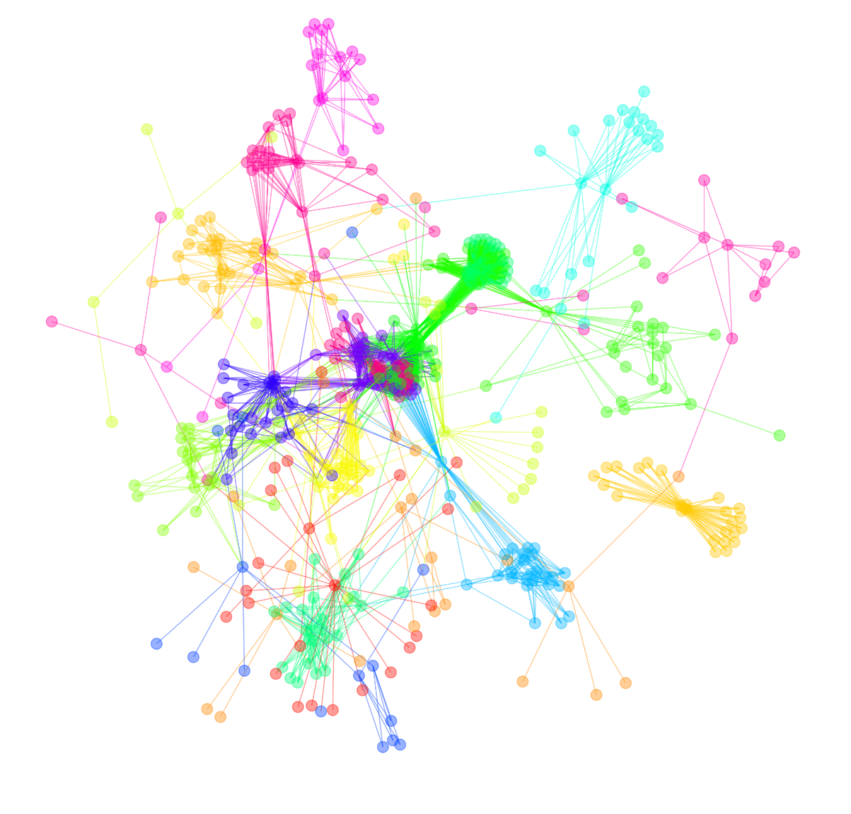


ABCA7 loss of function variants induce lipid disruption and
DNA damage in neurons
Djuna von Maydell*, Shannon Wright*, Maeve Bonner*
Tsai Lab, MIT

Slide 2
Disclosure:
Patent application for cyclodextrin and analogues as an Alzheimer’s disease therapeutic (Provisional Patent Application No. 63/160,877)

Slide 3
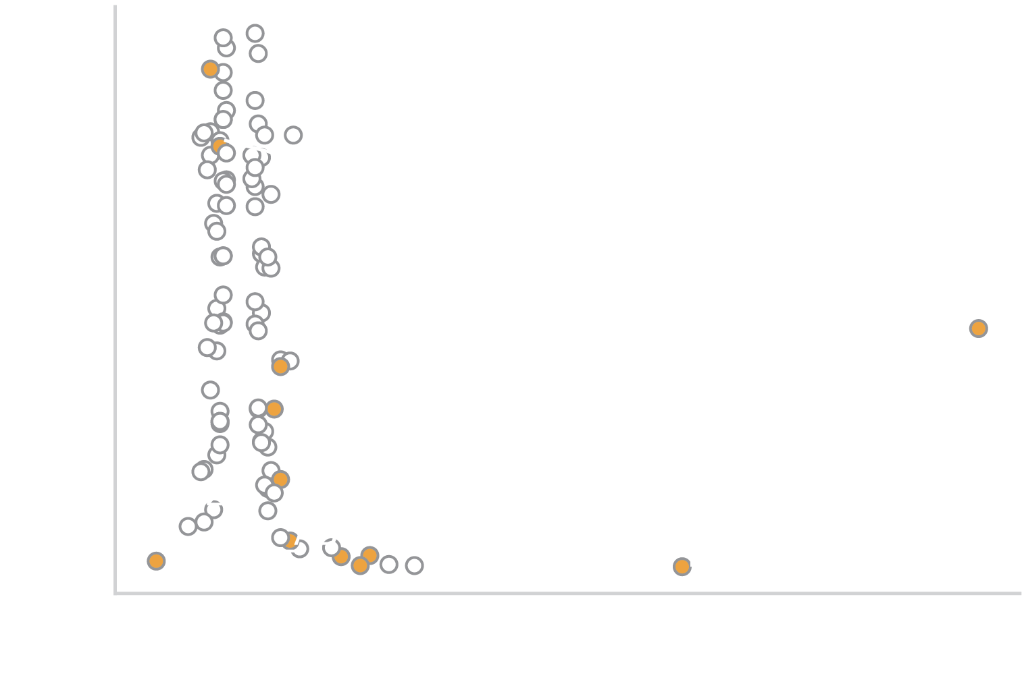
Coding variants implicated in Alzheimer’s disease through genome-wide association studies (GWAS)
Protein-coding variant
Data source: Kunkle et al, Table 1, Nat Genet 51, 414–430 (2019)

Slide 4
GWAS implicate ABCA7 in Alzheimer’s disease risk
Protein-coding variant
Data source: Kunkle et al, Table 1, Nat Genet 51, 414–430 (2019)

Slide 5
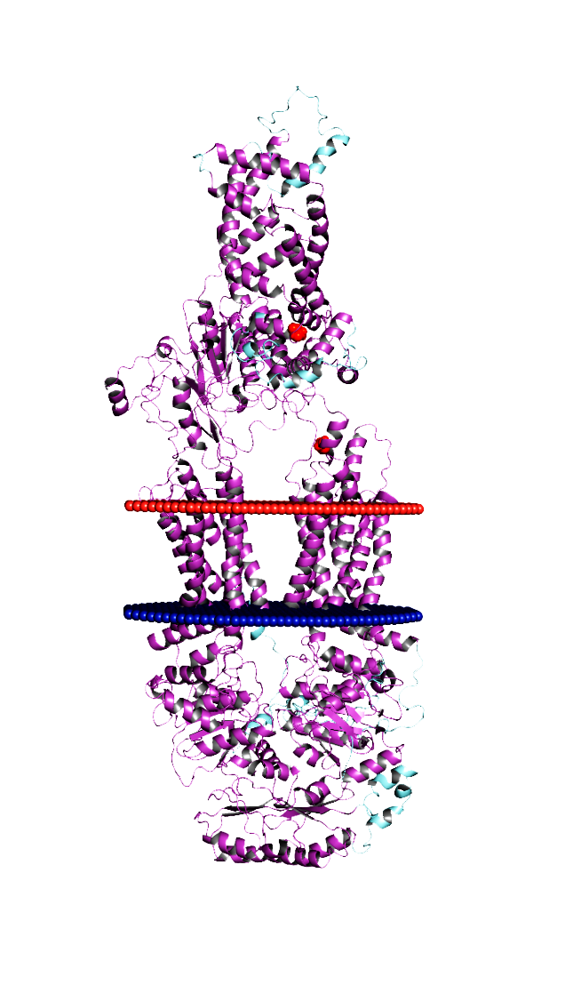
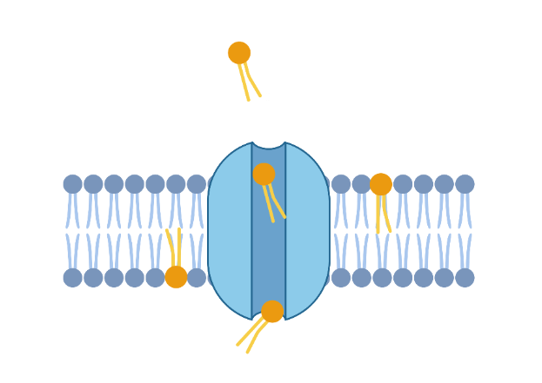
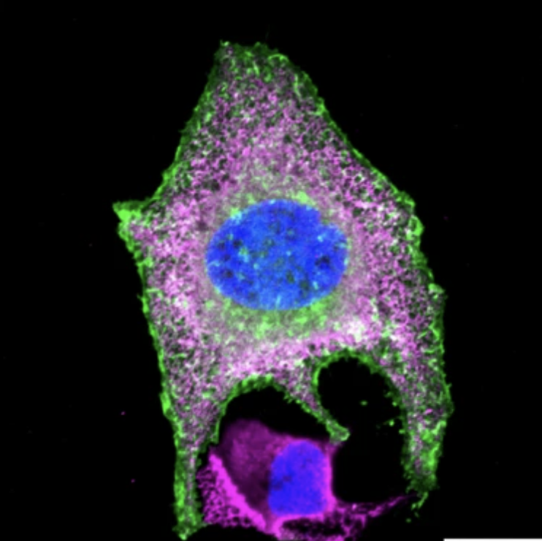
ABCA7 mediates inter-cellular lipid transport
Structure
Localization
Function
ABCA7
Calreticulin
Hoechst
A1527G
outer
inner
See also:
Let et al, he EMBO Journal (2023)42:e111065
Quazi et al, J Biol Chem. 2013 Nov 29; 288(48): 34414–34426.
Daleke, , JBC Papers in Press, November 27, 2006, DOI 10.1074/jbc.R600035200
20 µm
(left) Structural representation of ABCA7 (PDB ID 8EEB) in intermediate open conformation, Andrea Spitaleri
(middle) Adapted from Bossaerts et al, acta neuropathol commun 10, 43 (2022), Permissions: CC BY 4.0, http://creativecommons.org/licenses/by/4.0/.
(right) Created with BioRender.com

Slide 6
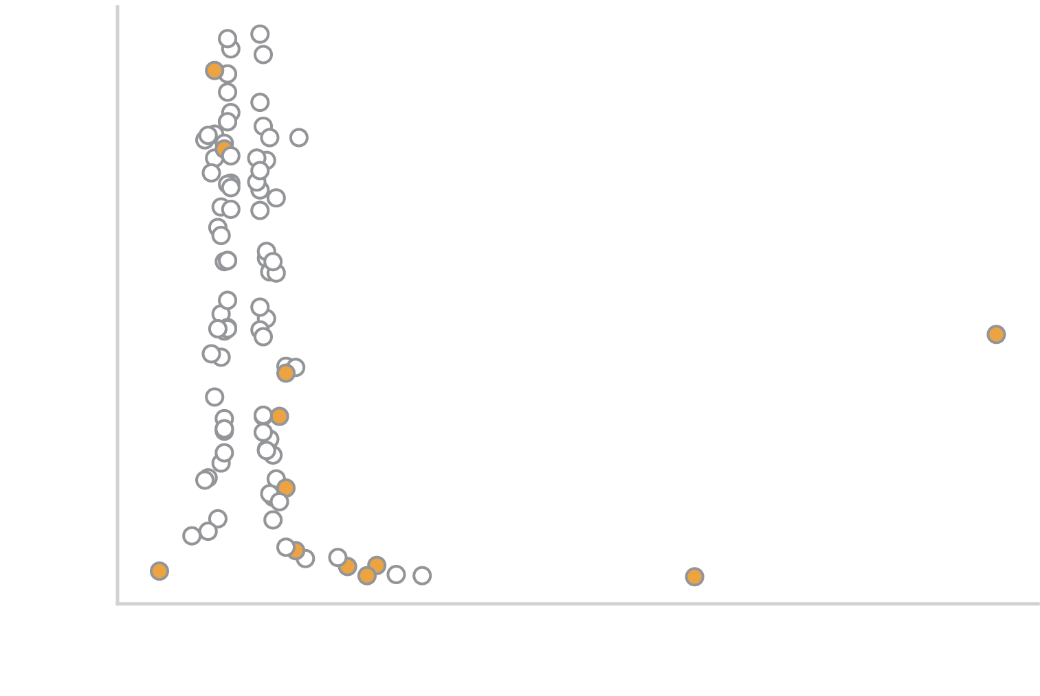
Rare loss-of-function (LoF) variants in ABCA7 increase risk of Alzheimer’s disease
See also:
Holstege et al, Nat Genet 54, 1786–1794 (2022). https://doi.org/10.1038/s41588-022-01208-7
Steinberg et al, Nat Genet 47, 445–447 (2015). https://doi.org/10.1038/ng.3246
Data source: Kunkle et al, Table 1, Nat Genet 51, 414–430 (2019)

Slide 7
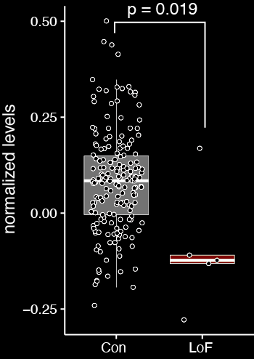
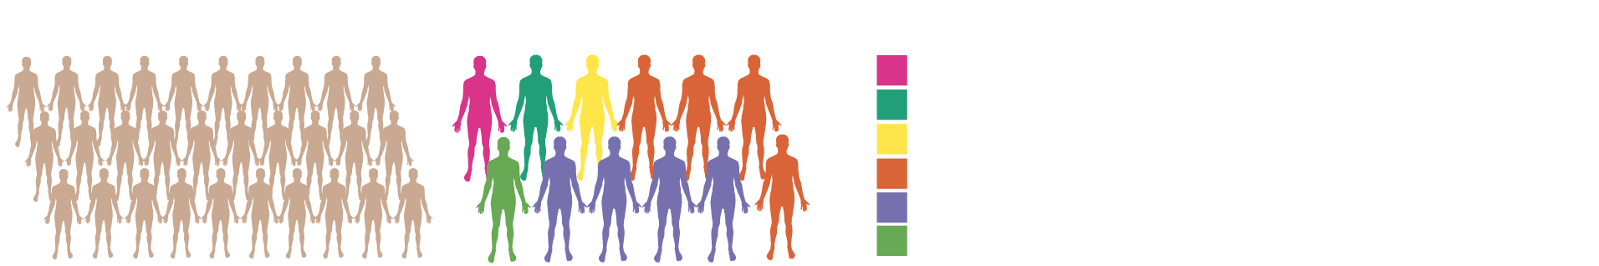
ABCA7 LoF variants likely increase risk through haploinsufficiency
ABCA7 protein levels in human PFC
See also:
Bossaerts et al, acta neuropathol commun 10, 43 (2022)
De Roeck et al, Acta Neuropathol 2019 Aug;138(2):201-220. doi: 10.1007/s00401-019-01994-1
N = 183
N = 5
Proteomics data available at:
https://www.synapse.org/#!Synapse:syn26452612 (syn26452612) (Emory University)

Slide 8
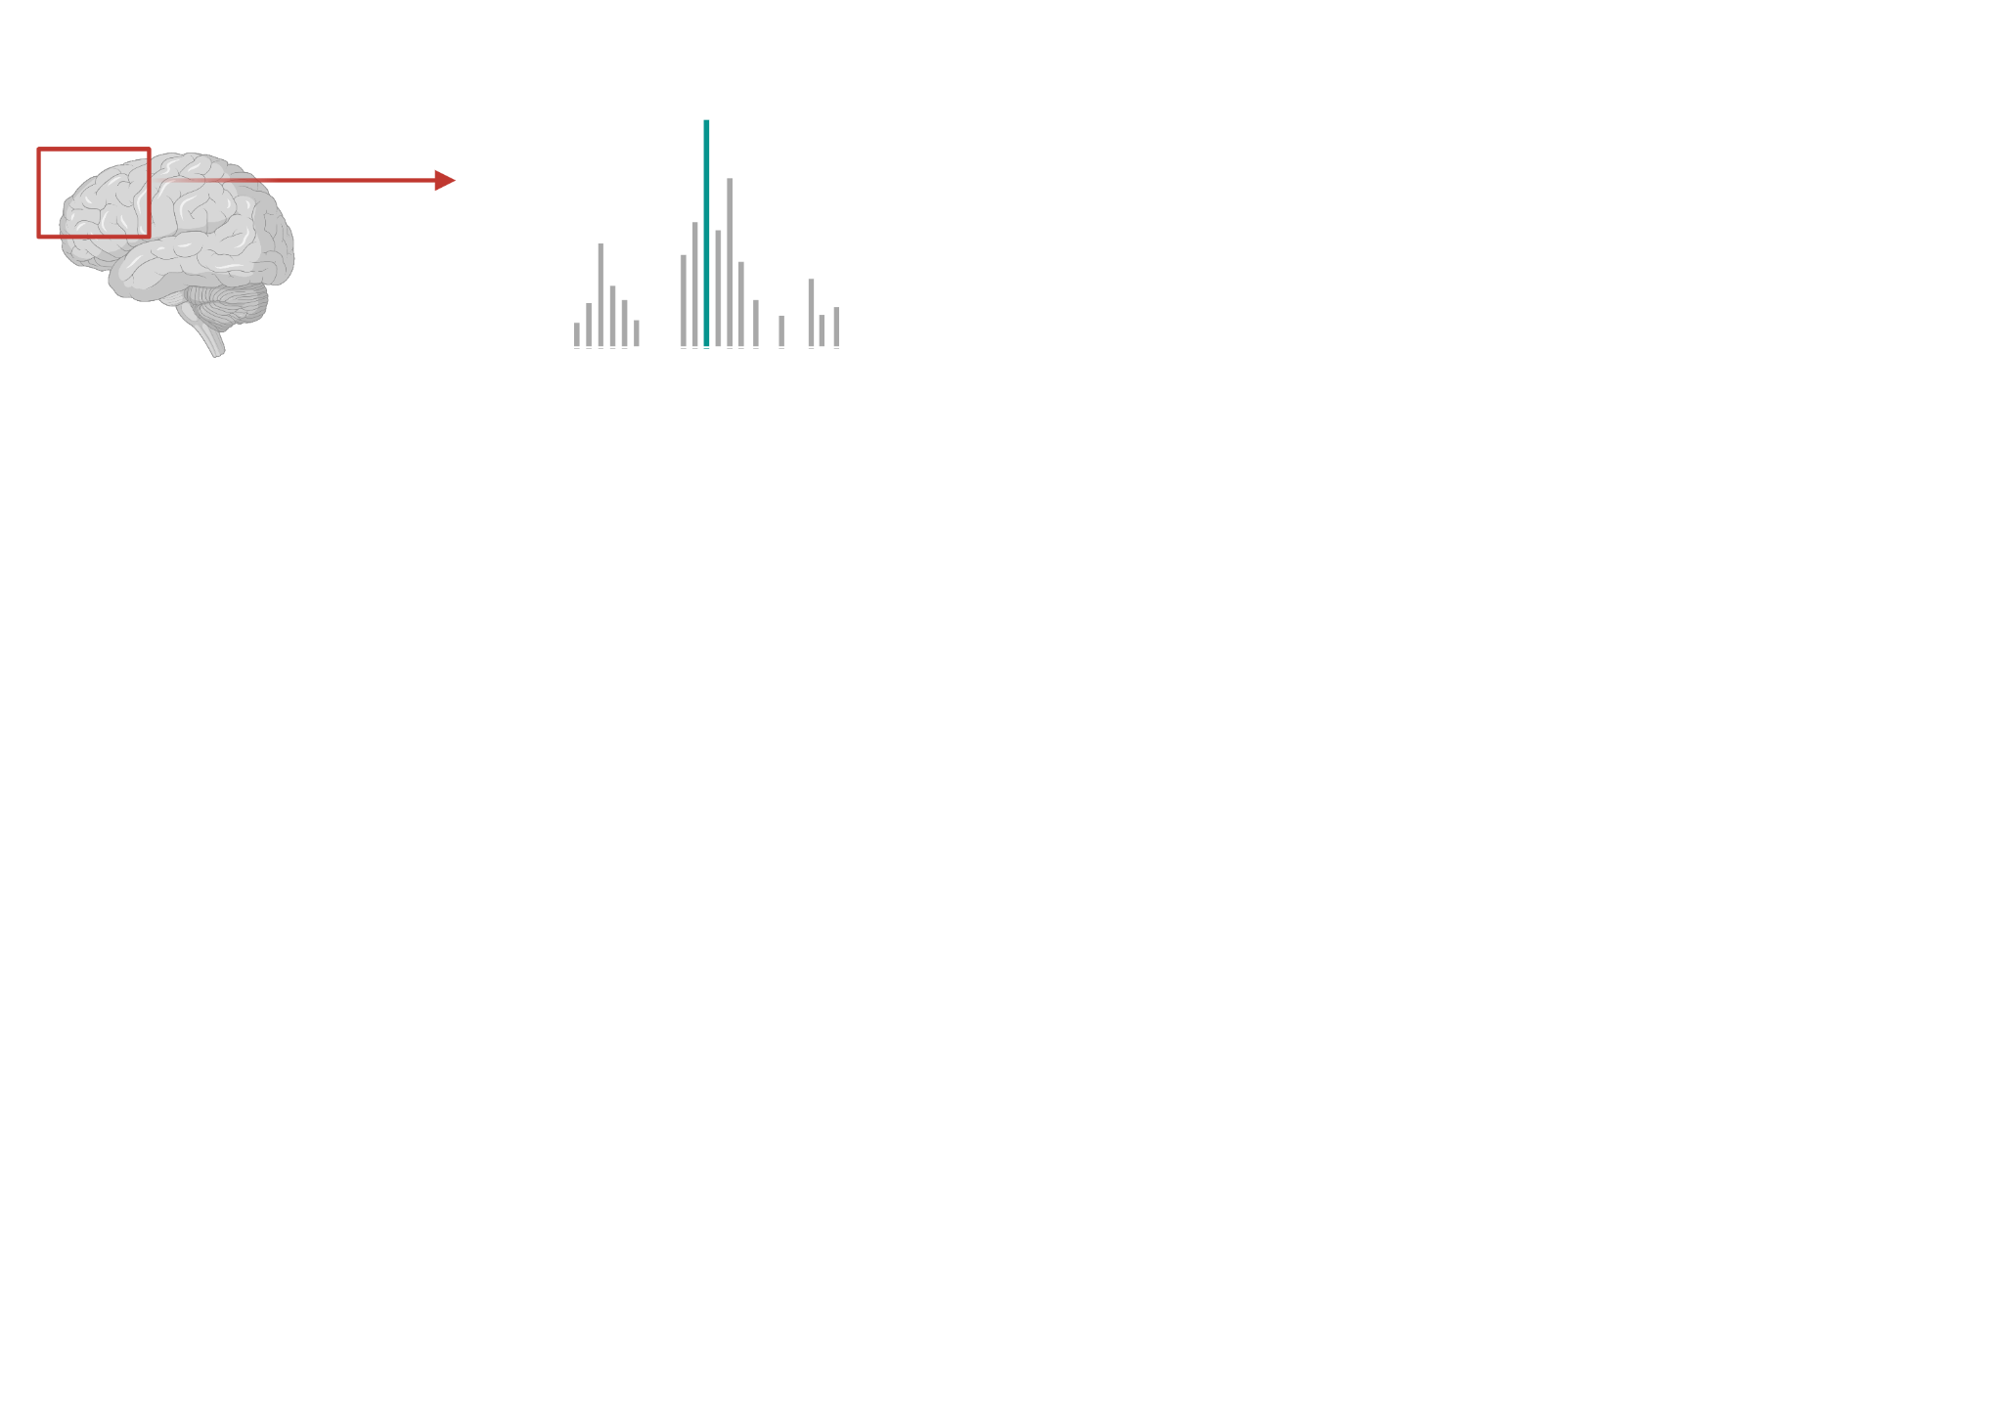
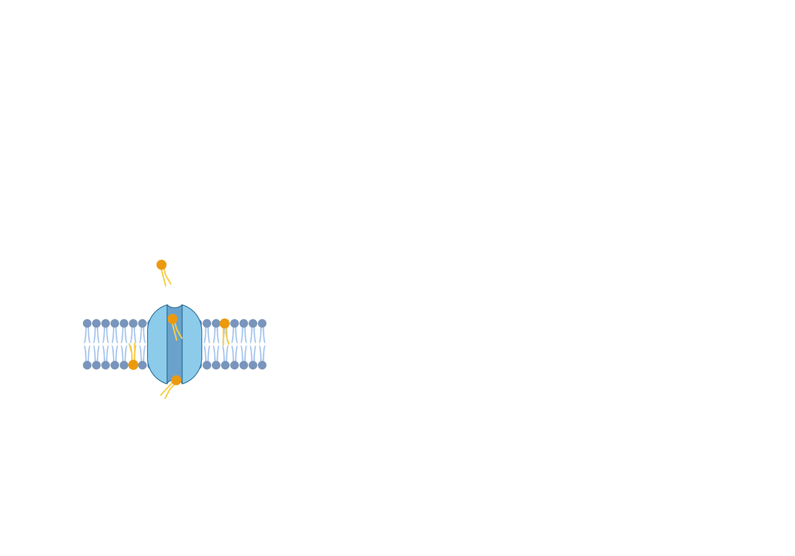
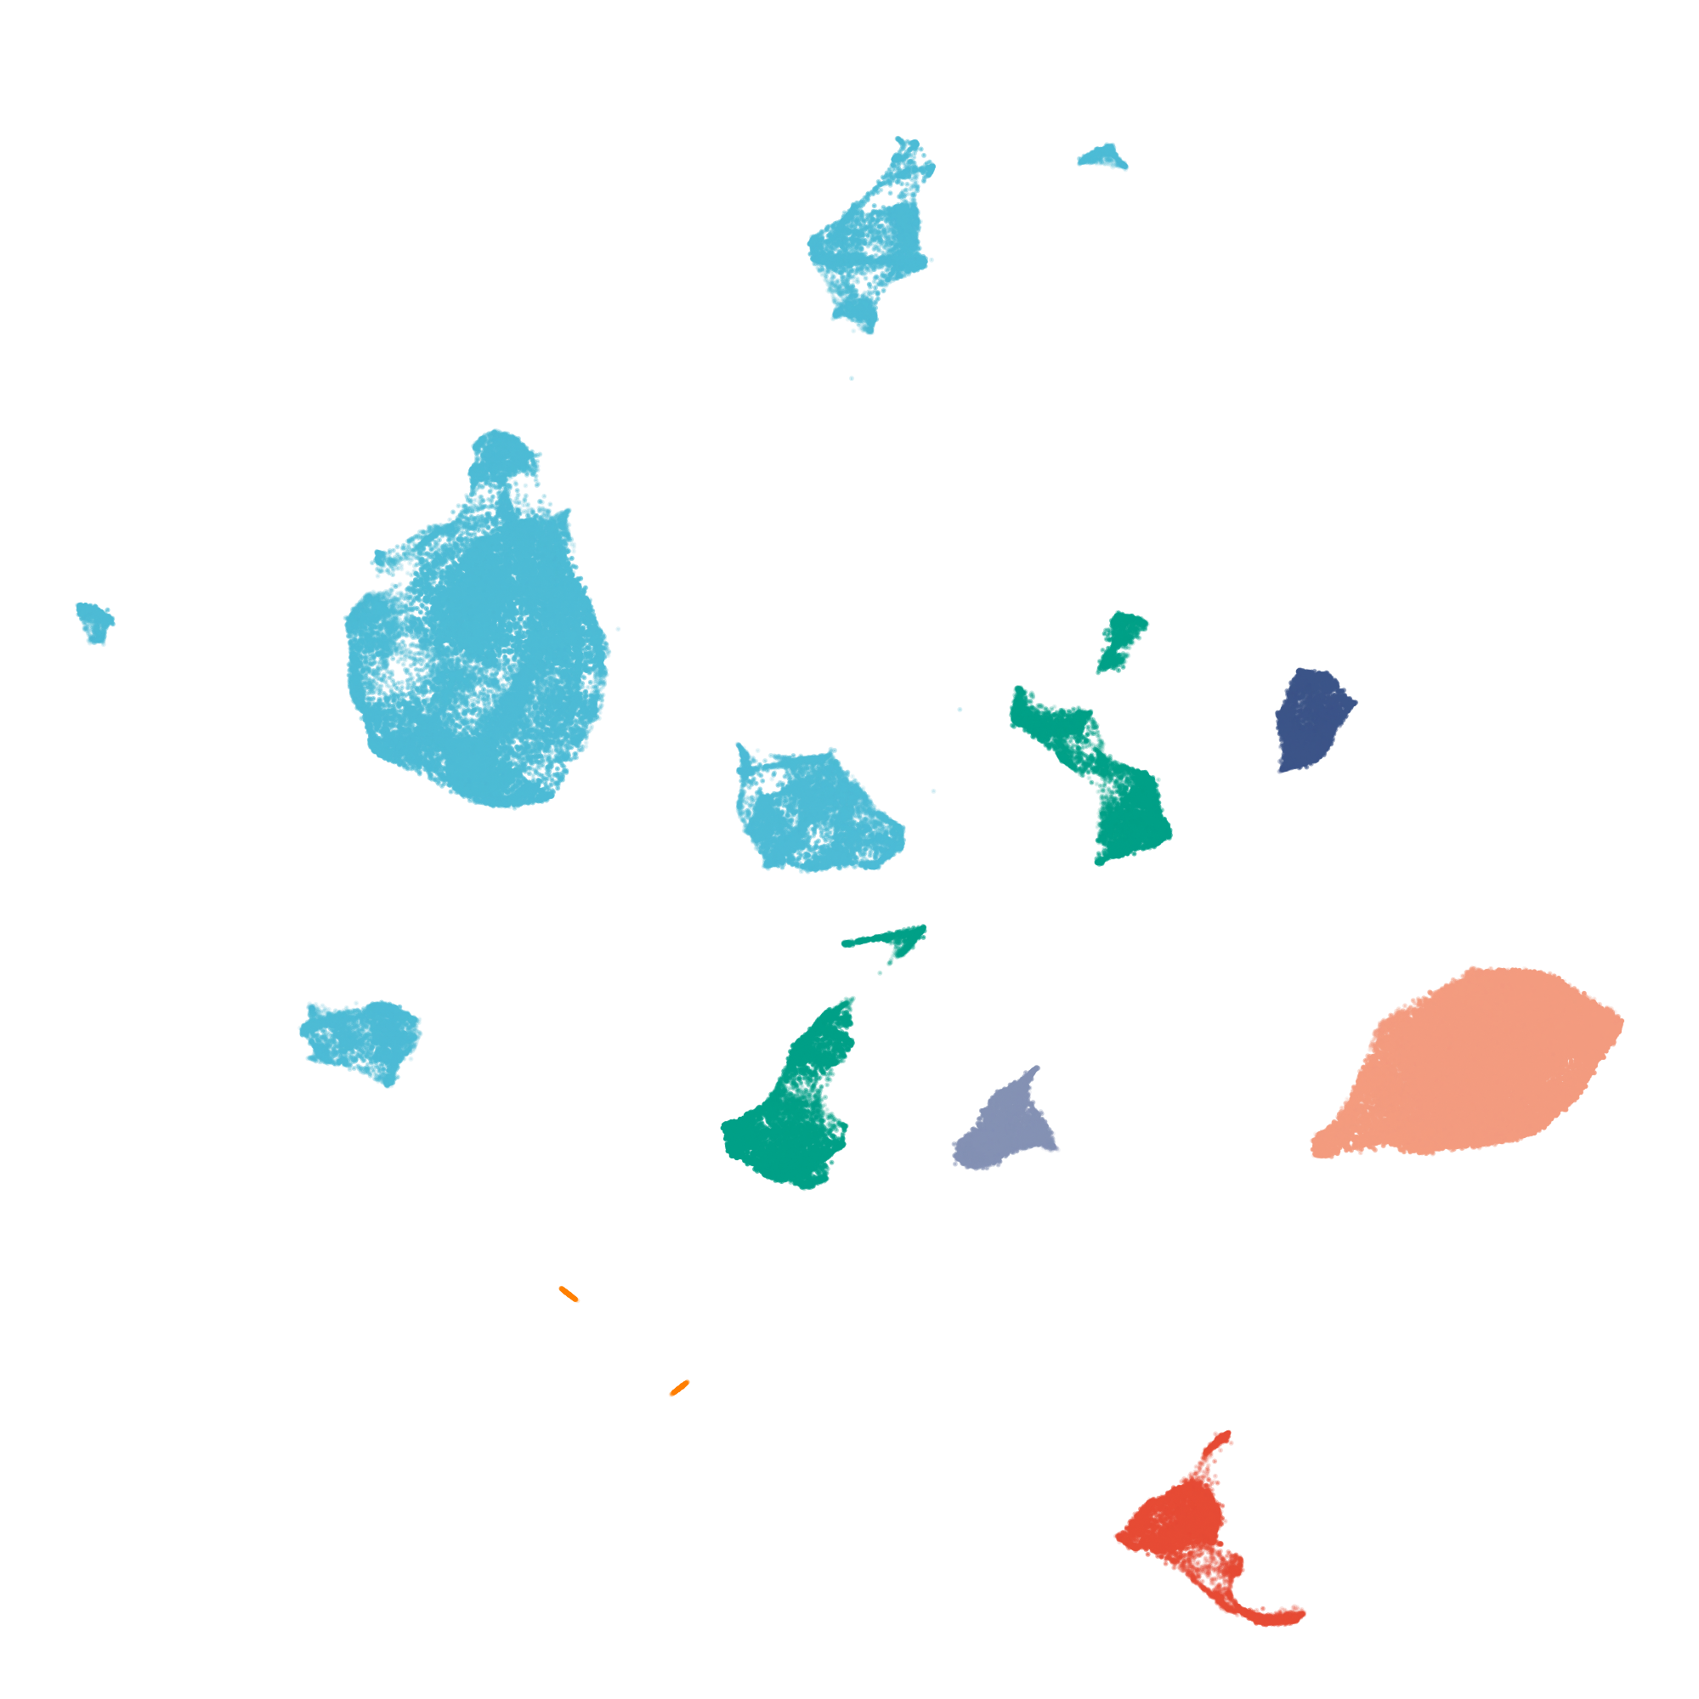
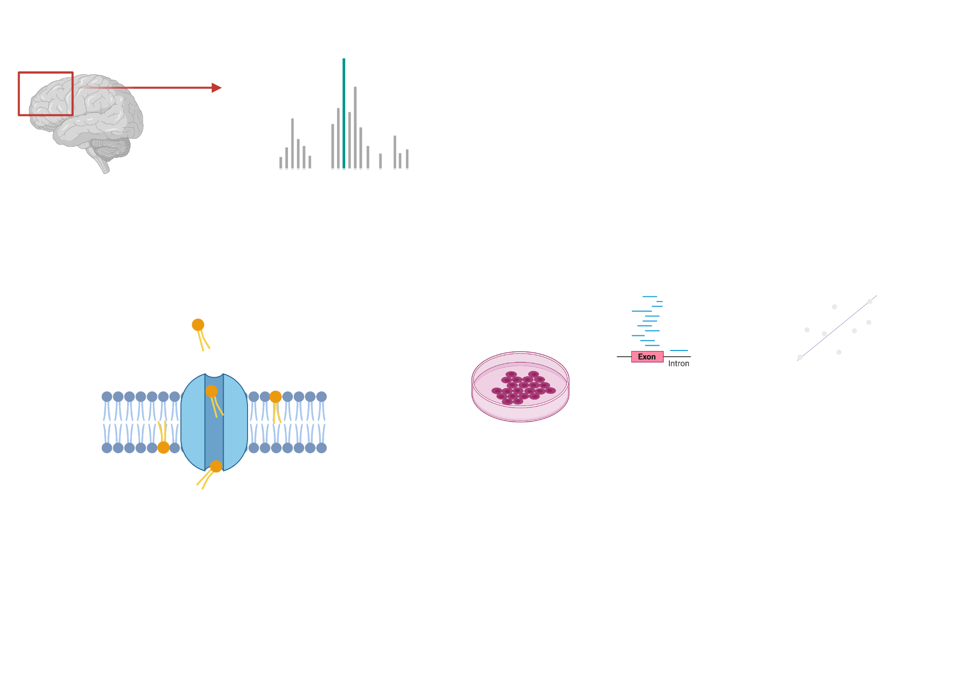
What are the cell-type-specific consequences of ABCA7 LoF variants?
Metabolic profiling of human brain
Carriers vs Controls
snRNAseq profiling
Predictions
Causal dissections in isogenic iPSCs
Some aspects created with BioRender.com

Slide 9
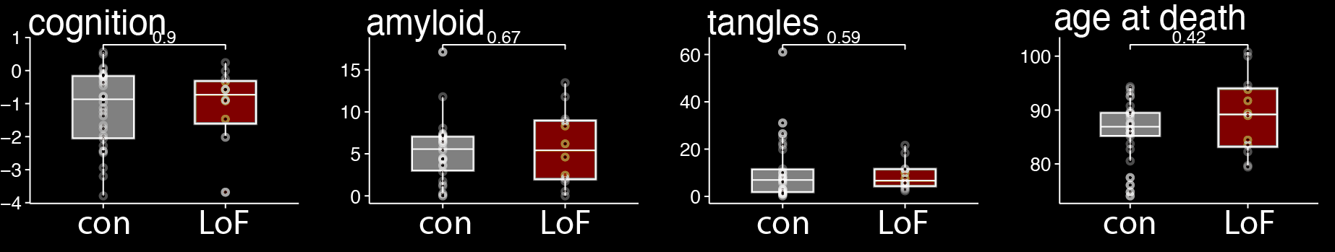
Assembling a cohort of ABCA7 LoF variant-carriers with available postmortem brain samples
Show how rare the ABCA7 variants are
N = 30
N = 12
Samples generously donated by subjects enrolled in the ROSMAP study (Rush RADC)

Slide 10
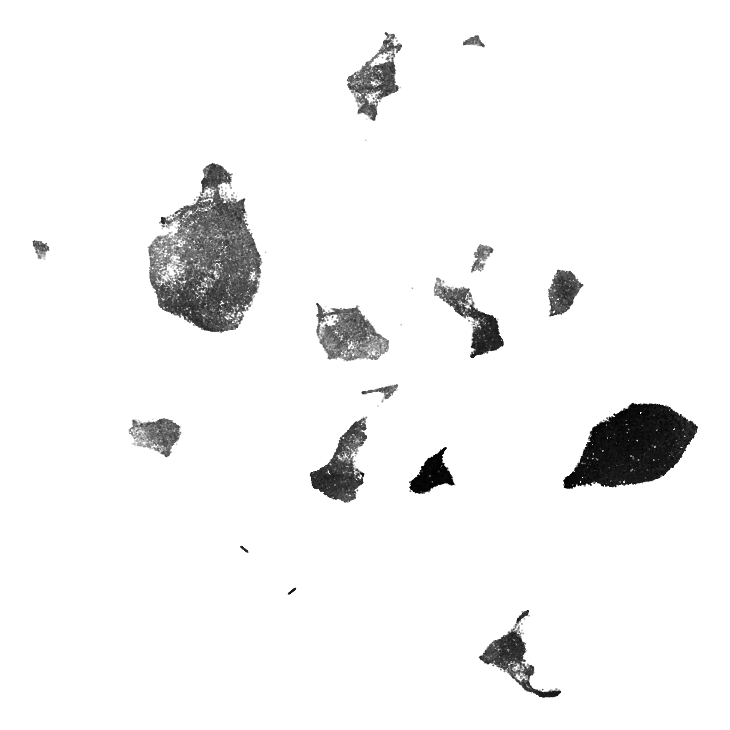
Major cell types
ABCA7 expression
Excitatory neurons
Inhibitory neurons
Microglia
Oligodendrocytes
Vascular
OPCs
High expression
UMAP 2
Astrocytes
Low expression
UMAP 1

Slide 11
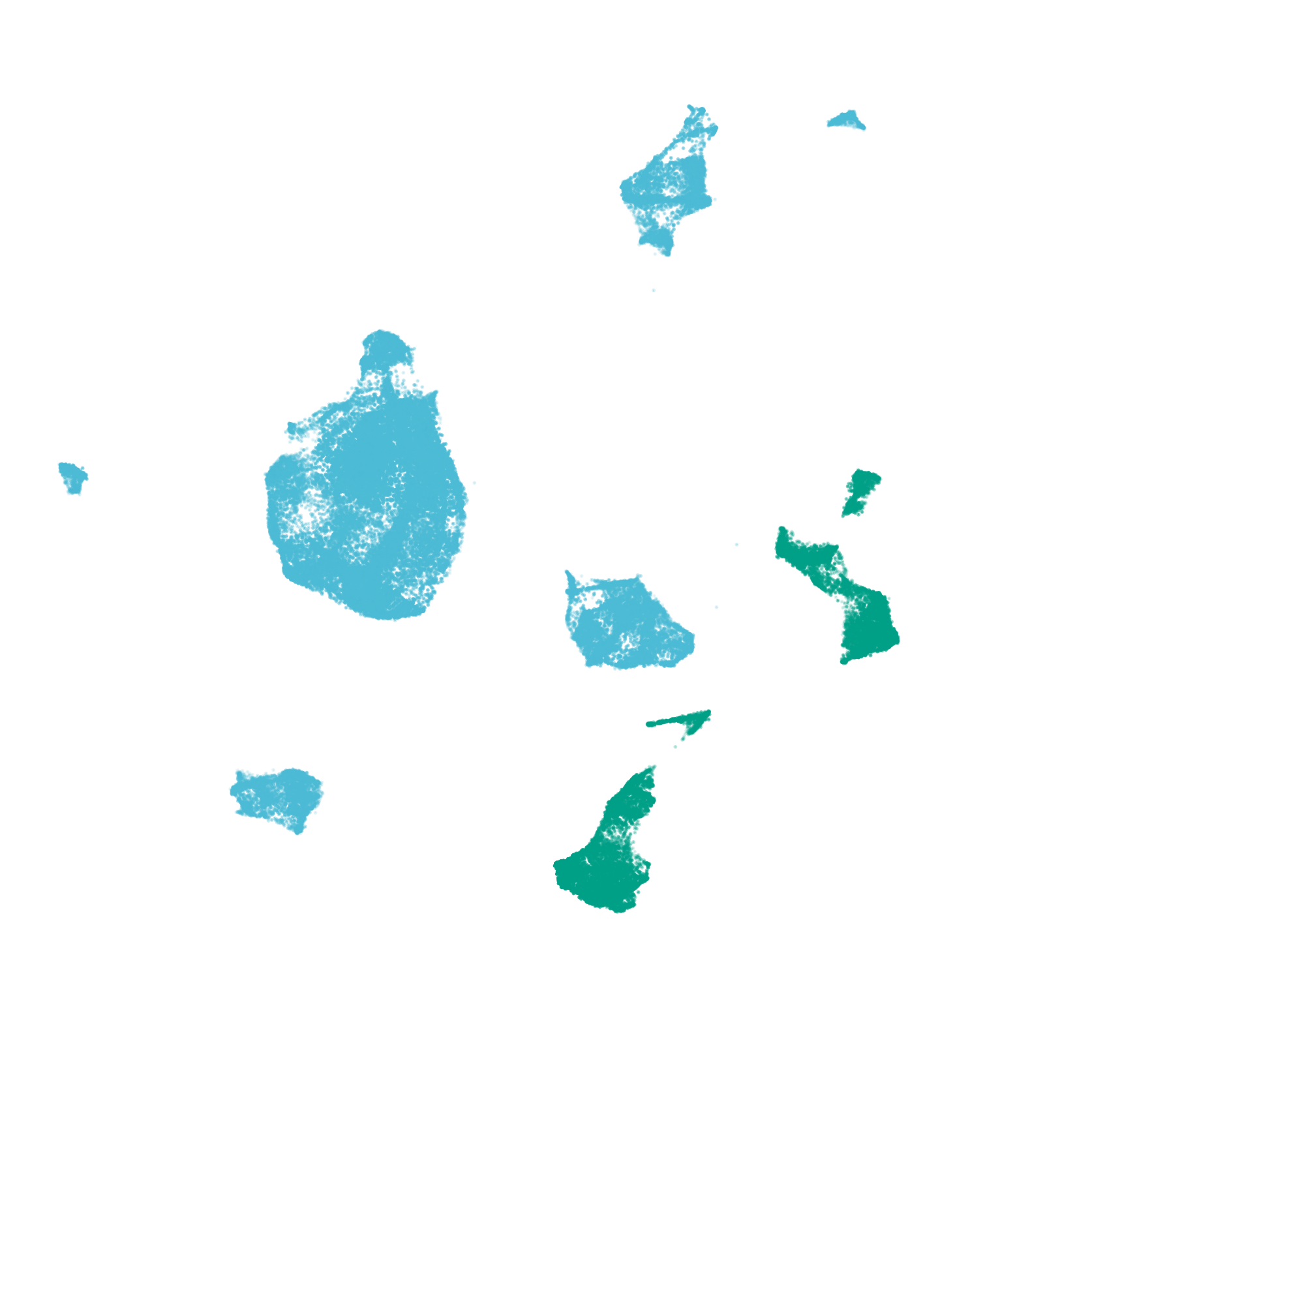


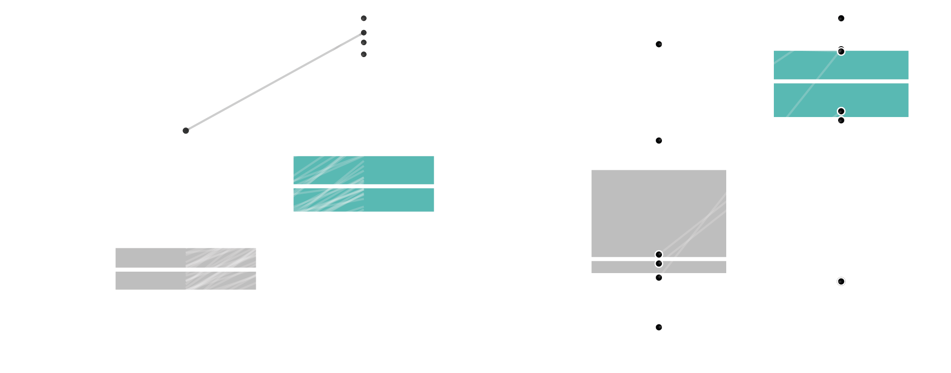
ABCA7 expression is higher in neurons vs non-neuronal cells in human brain
snRNAseq
Bulk RNA-seq
normalized expression
Data source (right):
Welch et al, SCIENCE ADVANCES
28 Sep 2022
Vol 8, Issue 39
DOI: 10.1126/sciadv.abo4662

Slide 12
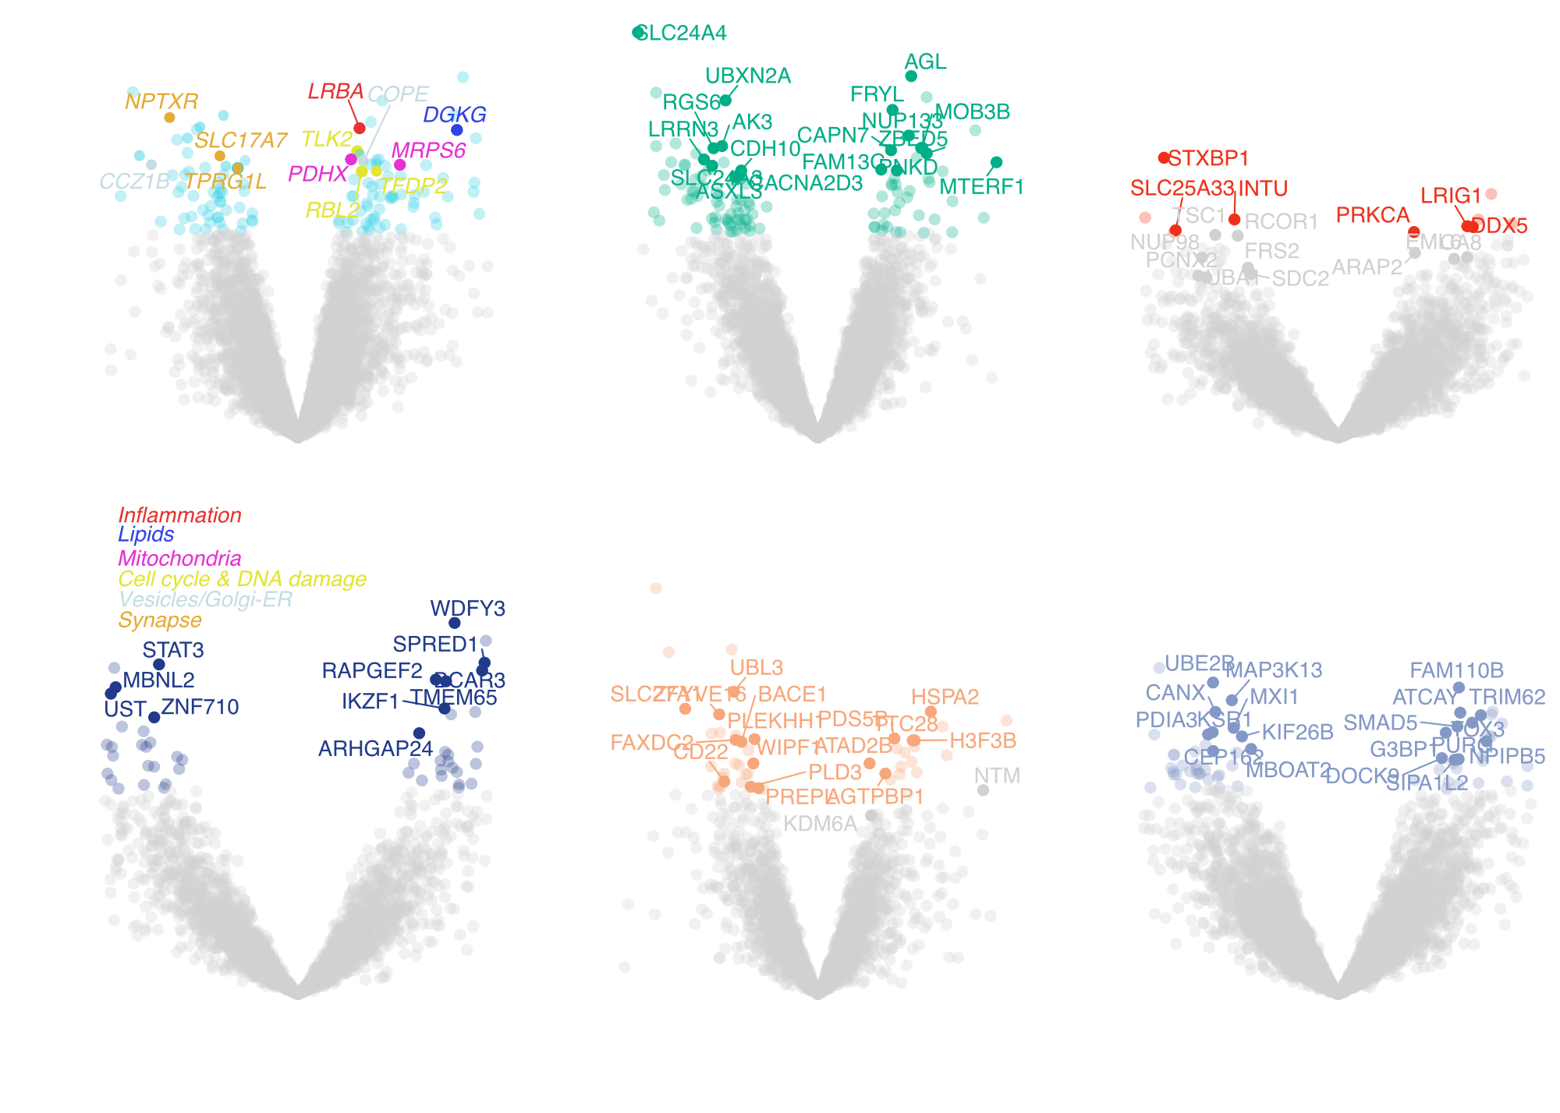
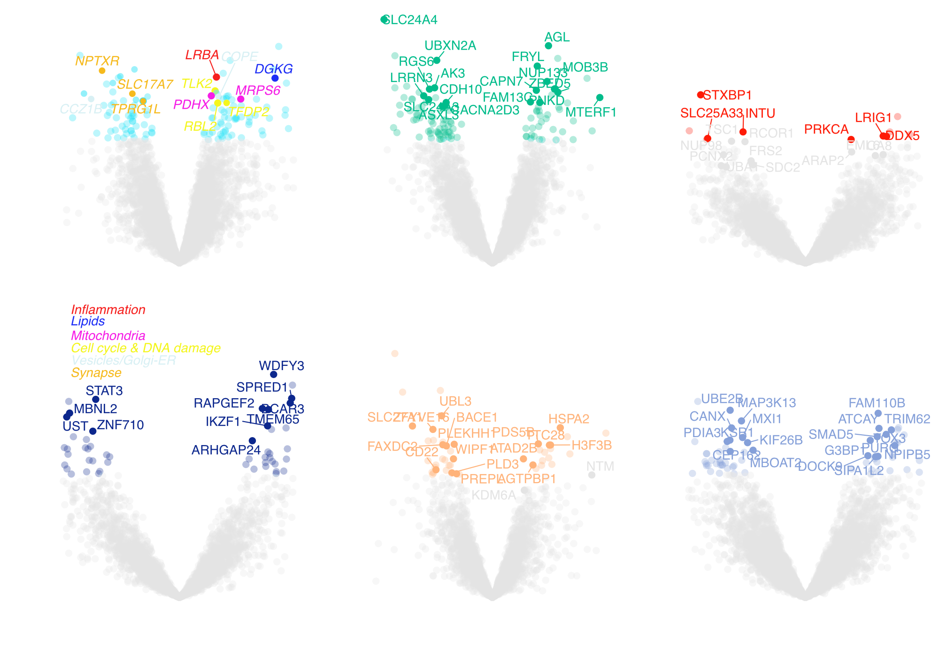

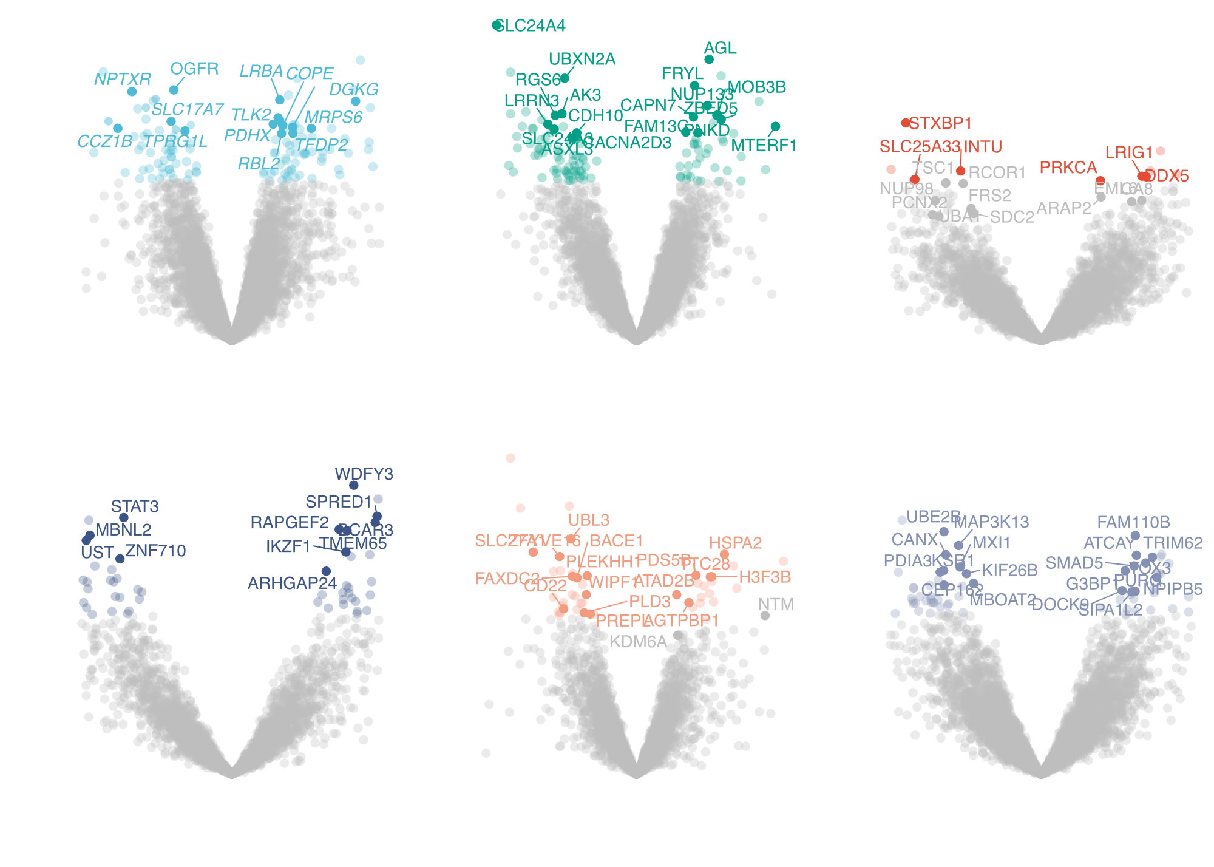
ABCA7 LoF - associated gene changes in excitatory neurons
Excitatory neurons
Significance
Down in LoF
Up in LoF
log2(fold change)

Slide 13
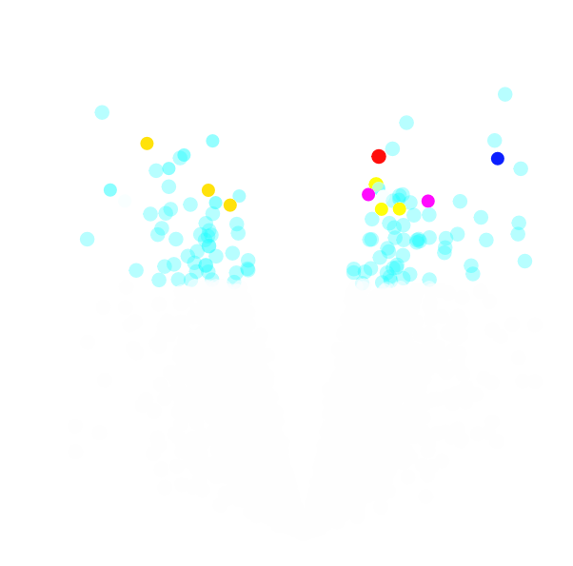
Gene redundancy in biological pathway databases
Measuring diverse biological effects?
Pathways
Or actually just a single effect?
Genes
significant

Slide 14

Partitioning bipartite graph into non-overlapping gene groups
1 Load input
2 Add missing edges
3 Initialize random solution
Loss: 3 + c
+1
+c
Genes
Pathways
5 Repeat 4 to convergence
4 Swap to minimize loss
Use Kernighan–Lin heuristic
Loss: 1 + 3c
In collaboration with the Madry Lab at MIT
https://github.com/djunamay/geneclusters

Slide 15
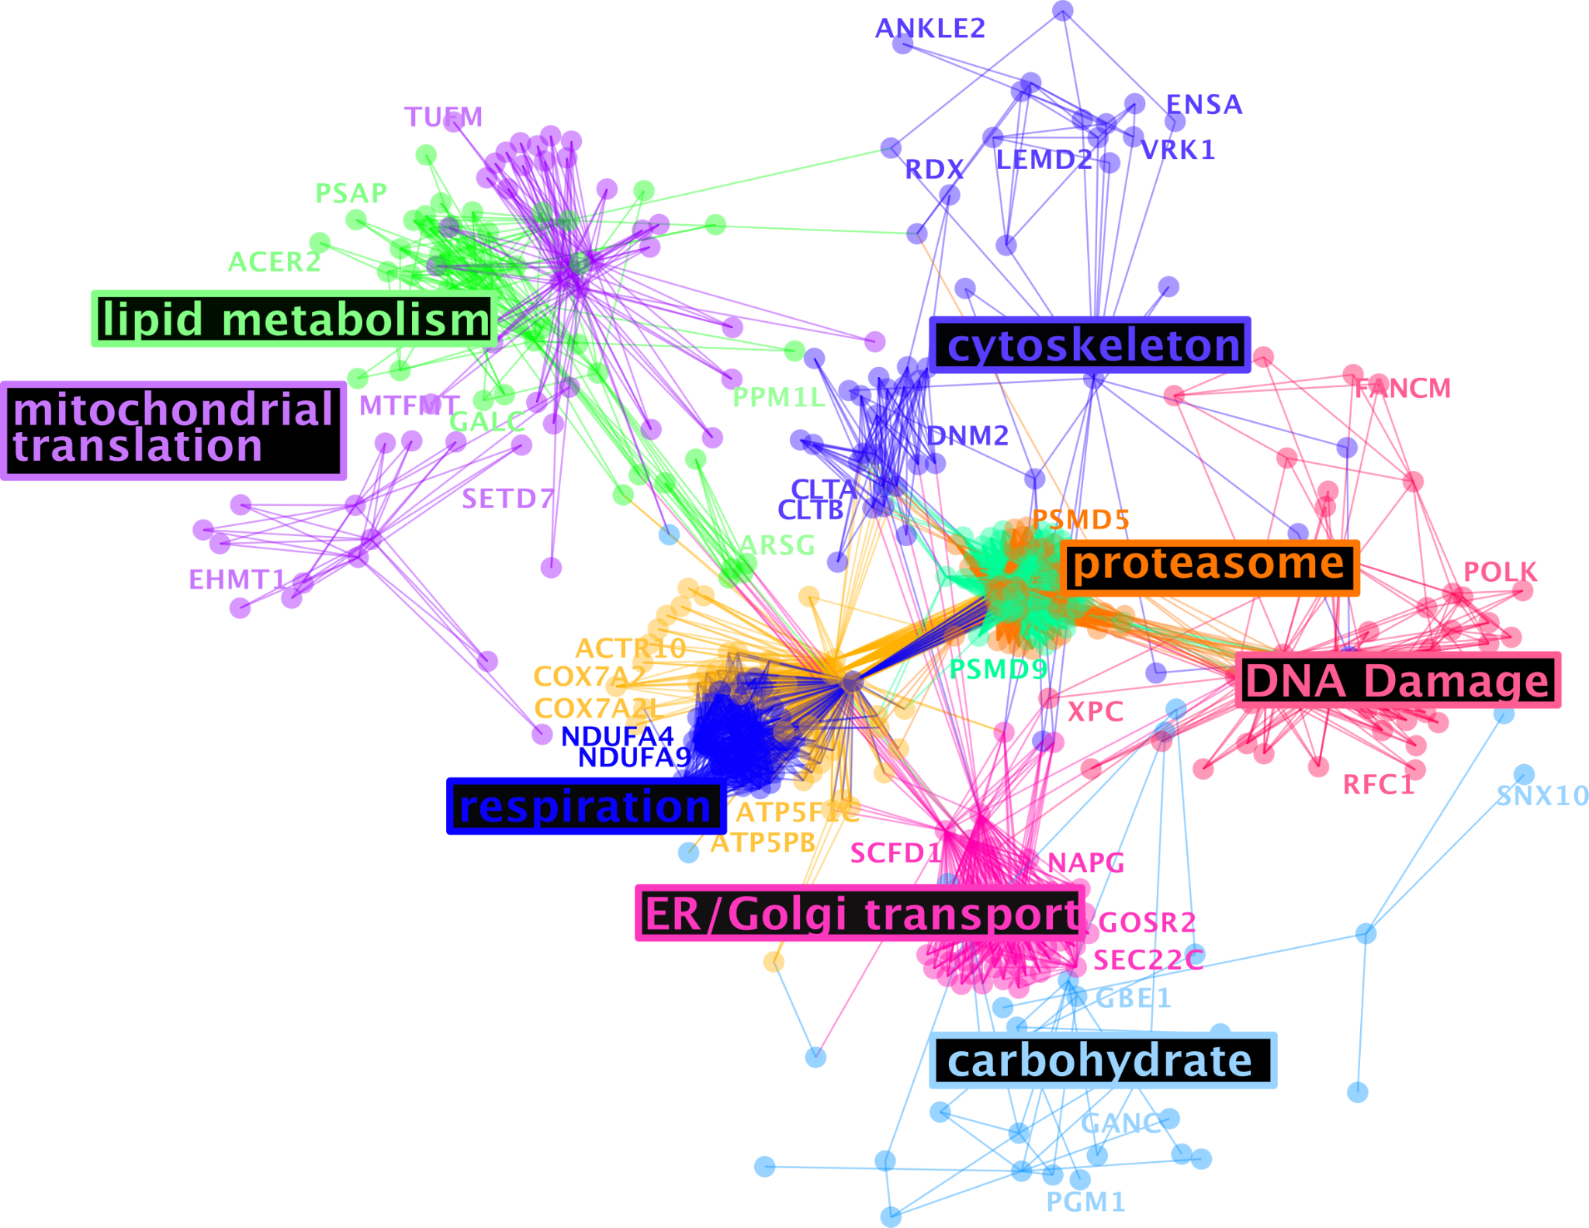
ABCA7 LoF gene cluster perturbations in excitatory neurons

Slide 16
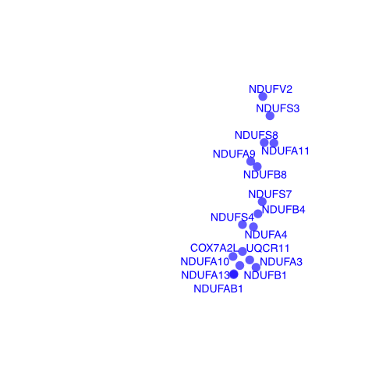
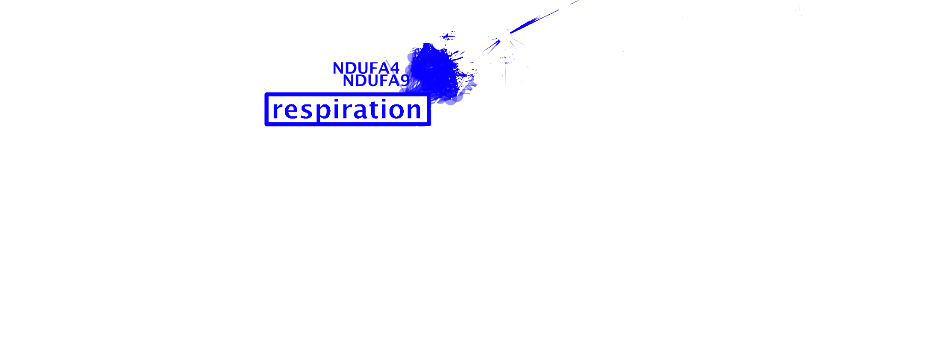
Mitochondrial gene changes in ABCA7 LoF
Complex I biogenesis

Slide 17
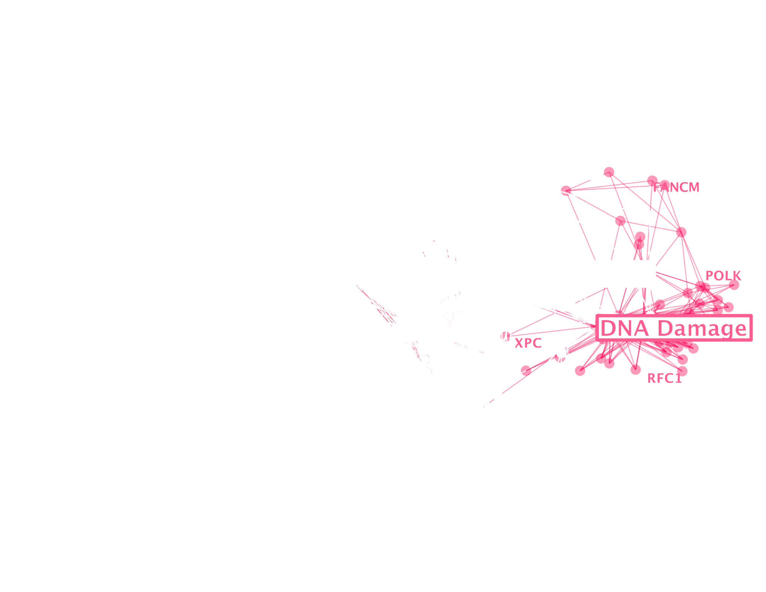
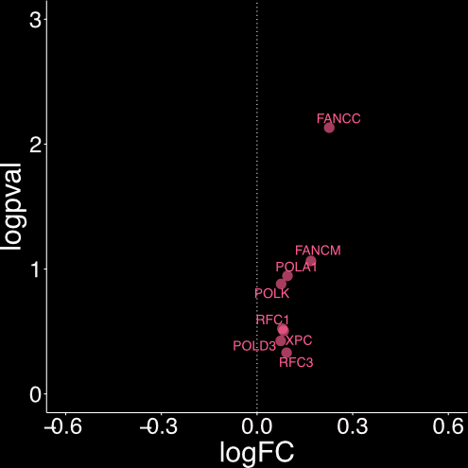
DNA damage genes are up-regulated in ABCA7 LoF
Mismatch repair (MMR) directed by MSH2:MSH6
Leading Strand Synthesis

Slide 18
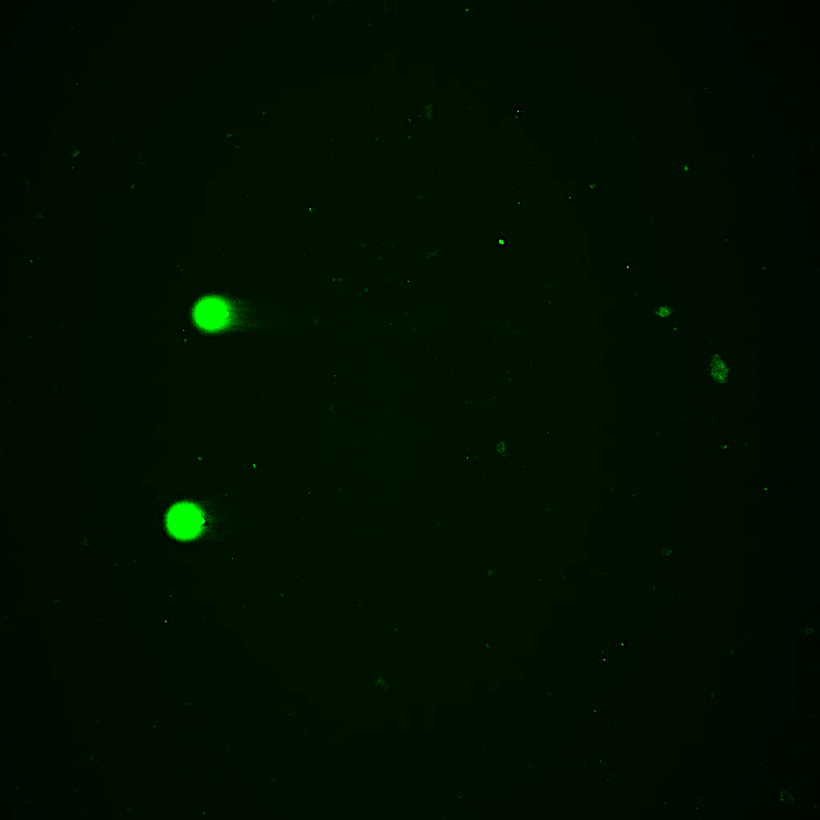
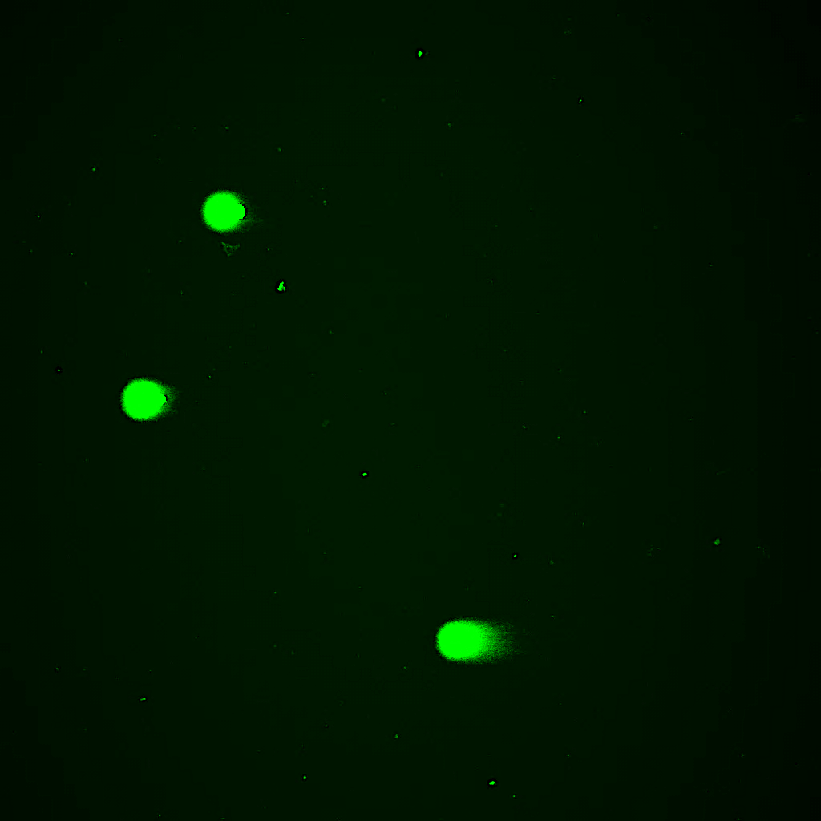

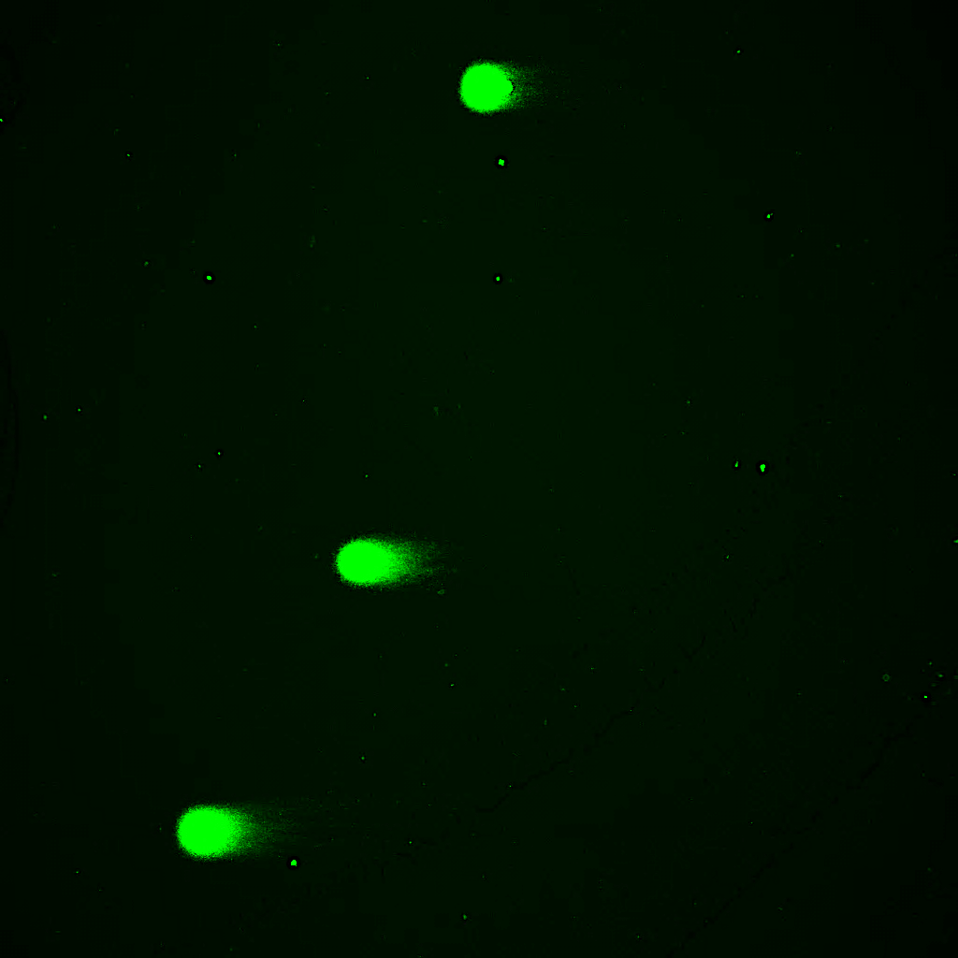
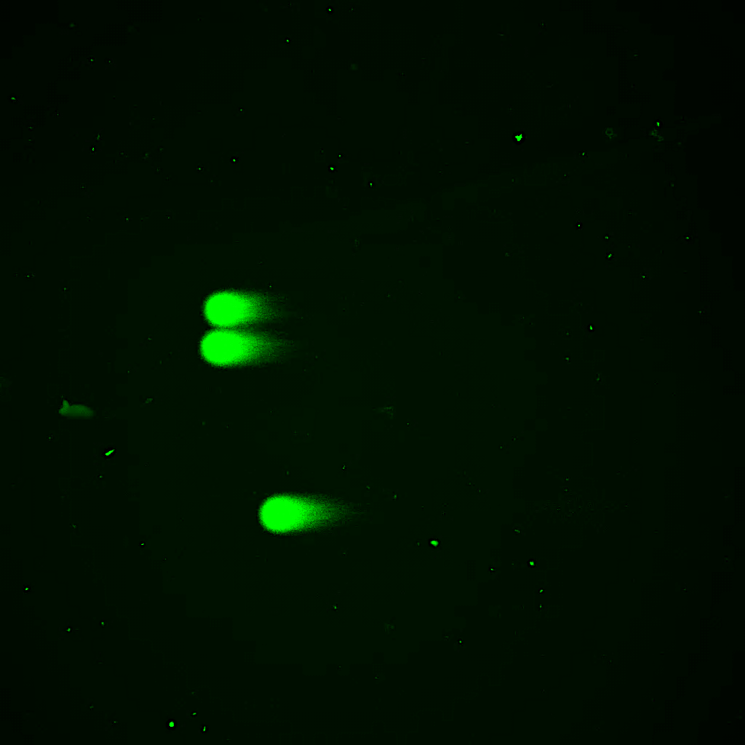
Increased DNA damage in ABCA7 LoF human brain
Individual #1
Individual #2
Control
Individual #1
Individual #2
ABCA7 LoF
1187 vs 1352 nuclei
Jenny Pao & Suella Menchaca

Slide 19
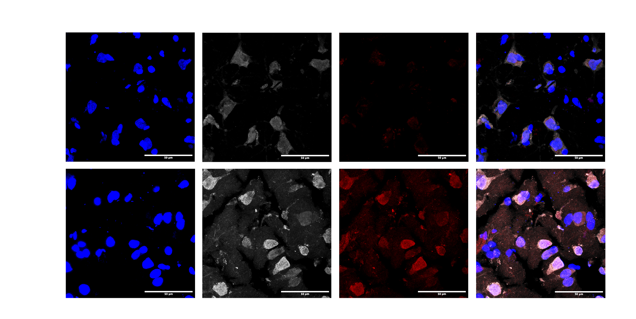

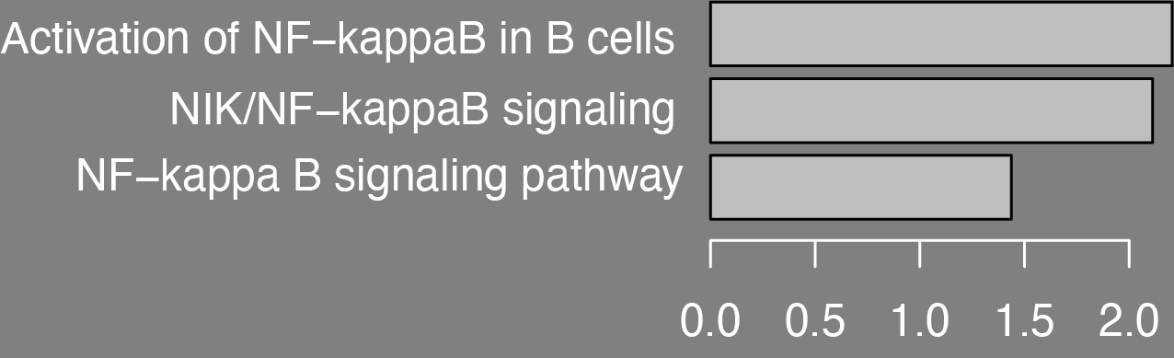
Increased nuclear localization of NFKB in ABCA7 LoF human brain
Normalized enrichment score
See also for DNA damage & inflammatory signaling in neurons:
Welch et al, SCIENCE ADVANCES, 2022, Vol 8, Issue 39DOI: 10.1126/sciadv.abo4662
Maeve Bonner

Slide 20
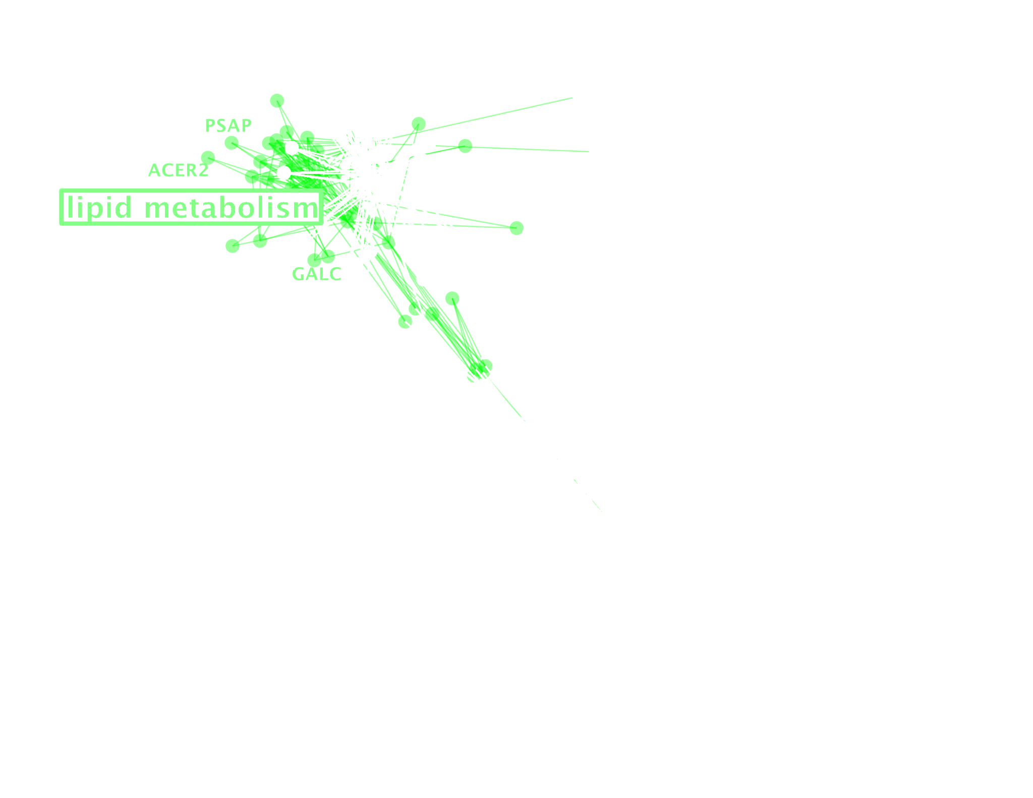
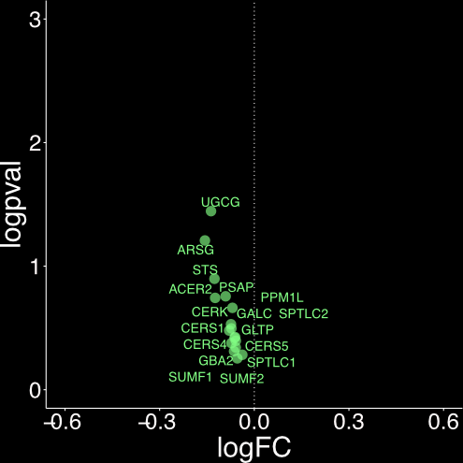
Changes to lipid metabolism genes in ABCA7 LoF
Sphingolipid Metabolism

Slide 21
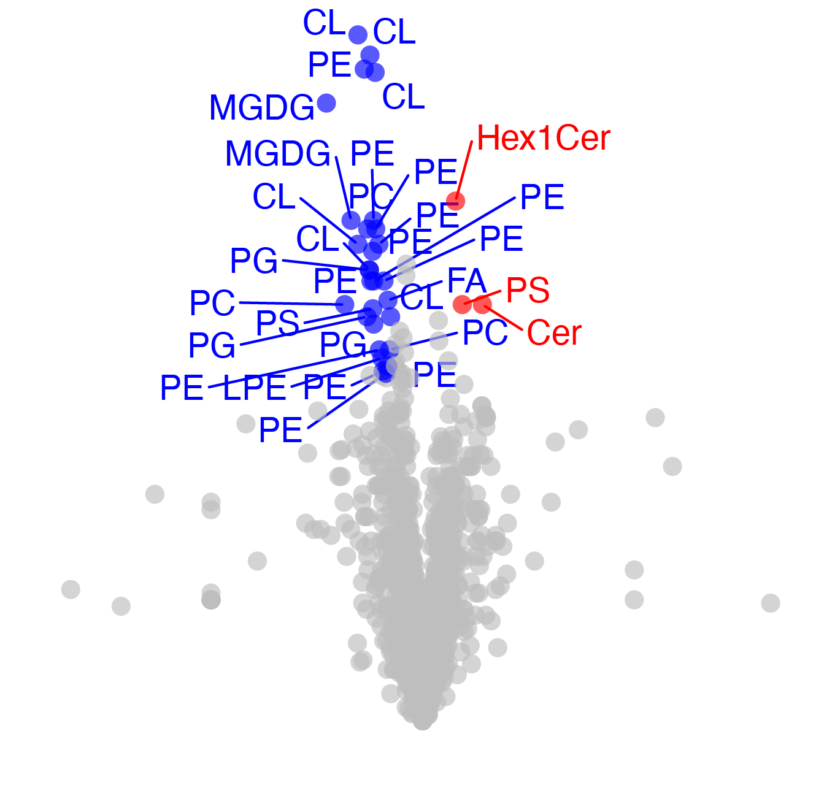
Is the lipidome altered in ABCA7 LoF brains?
cardiolipin
sphingolipid
phosphatidyl-choline
Dive into PLs/choline etc
Significance
Down in LoF
Up in LoF
Shannon Wright
log2(fold change)

Slide 22
How do these perturbations causally relate to one another?
?

Slide 23

How do these perturbations relate to one another?
CRISPRi target
ABCA7 LoF
CRISPRi target
CRISPRi data source: Tian et al Nat Neurosci 24, 1020–1034 (2021).
Available through www.crisprbrain.org ; Glutamatergic Neuron-RNA-Seq-CRISPRi-2020

Slide 24
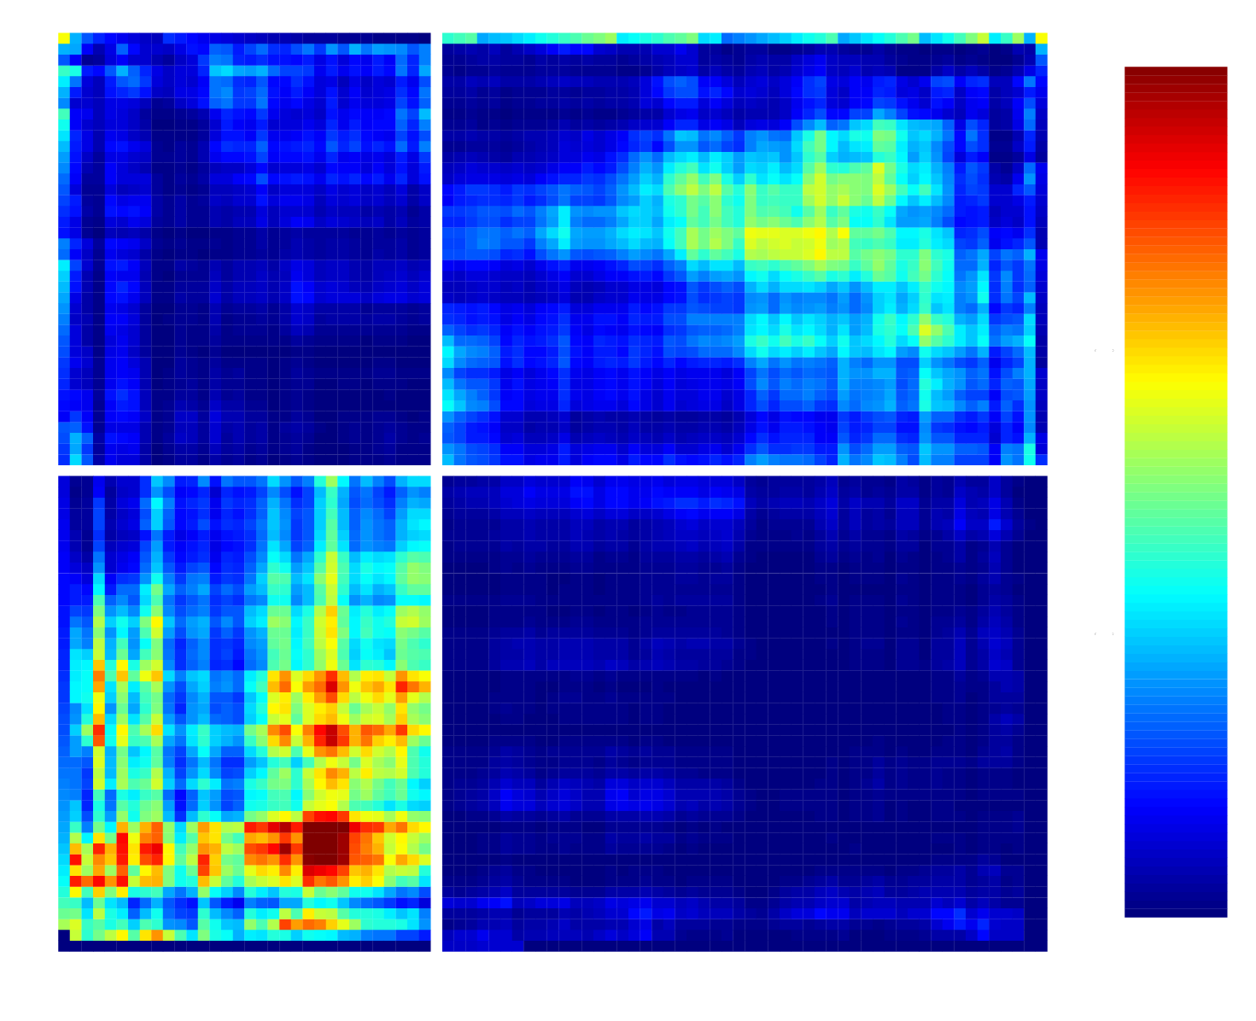
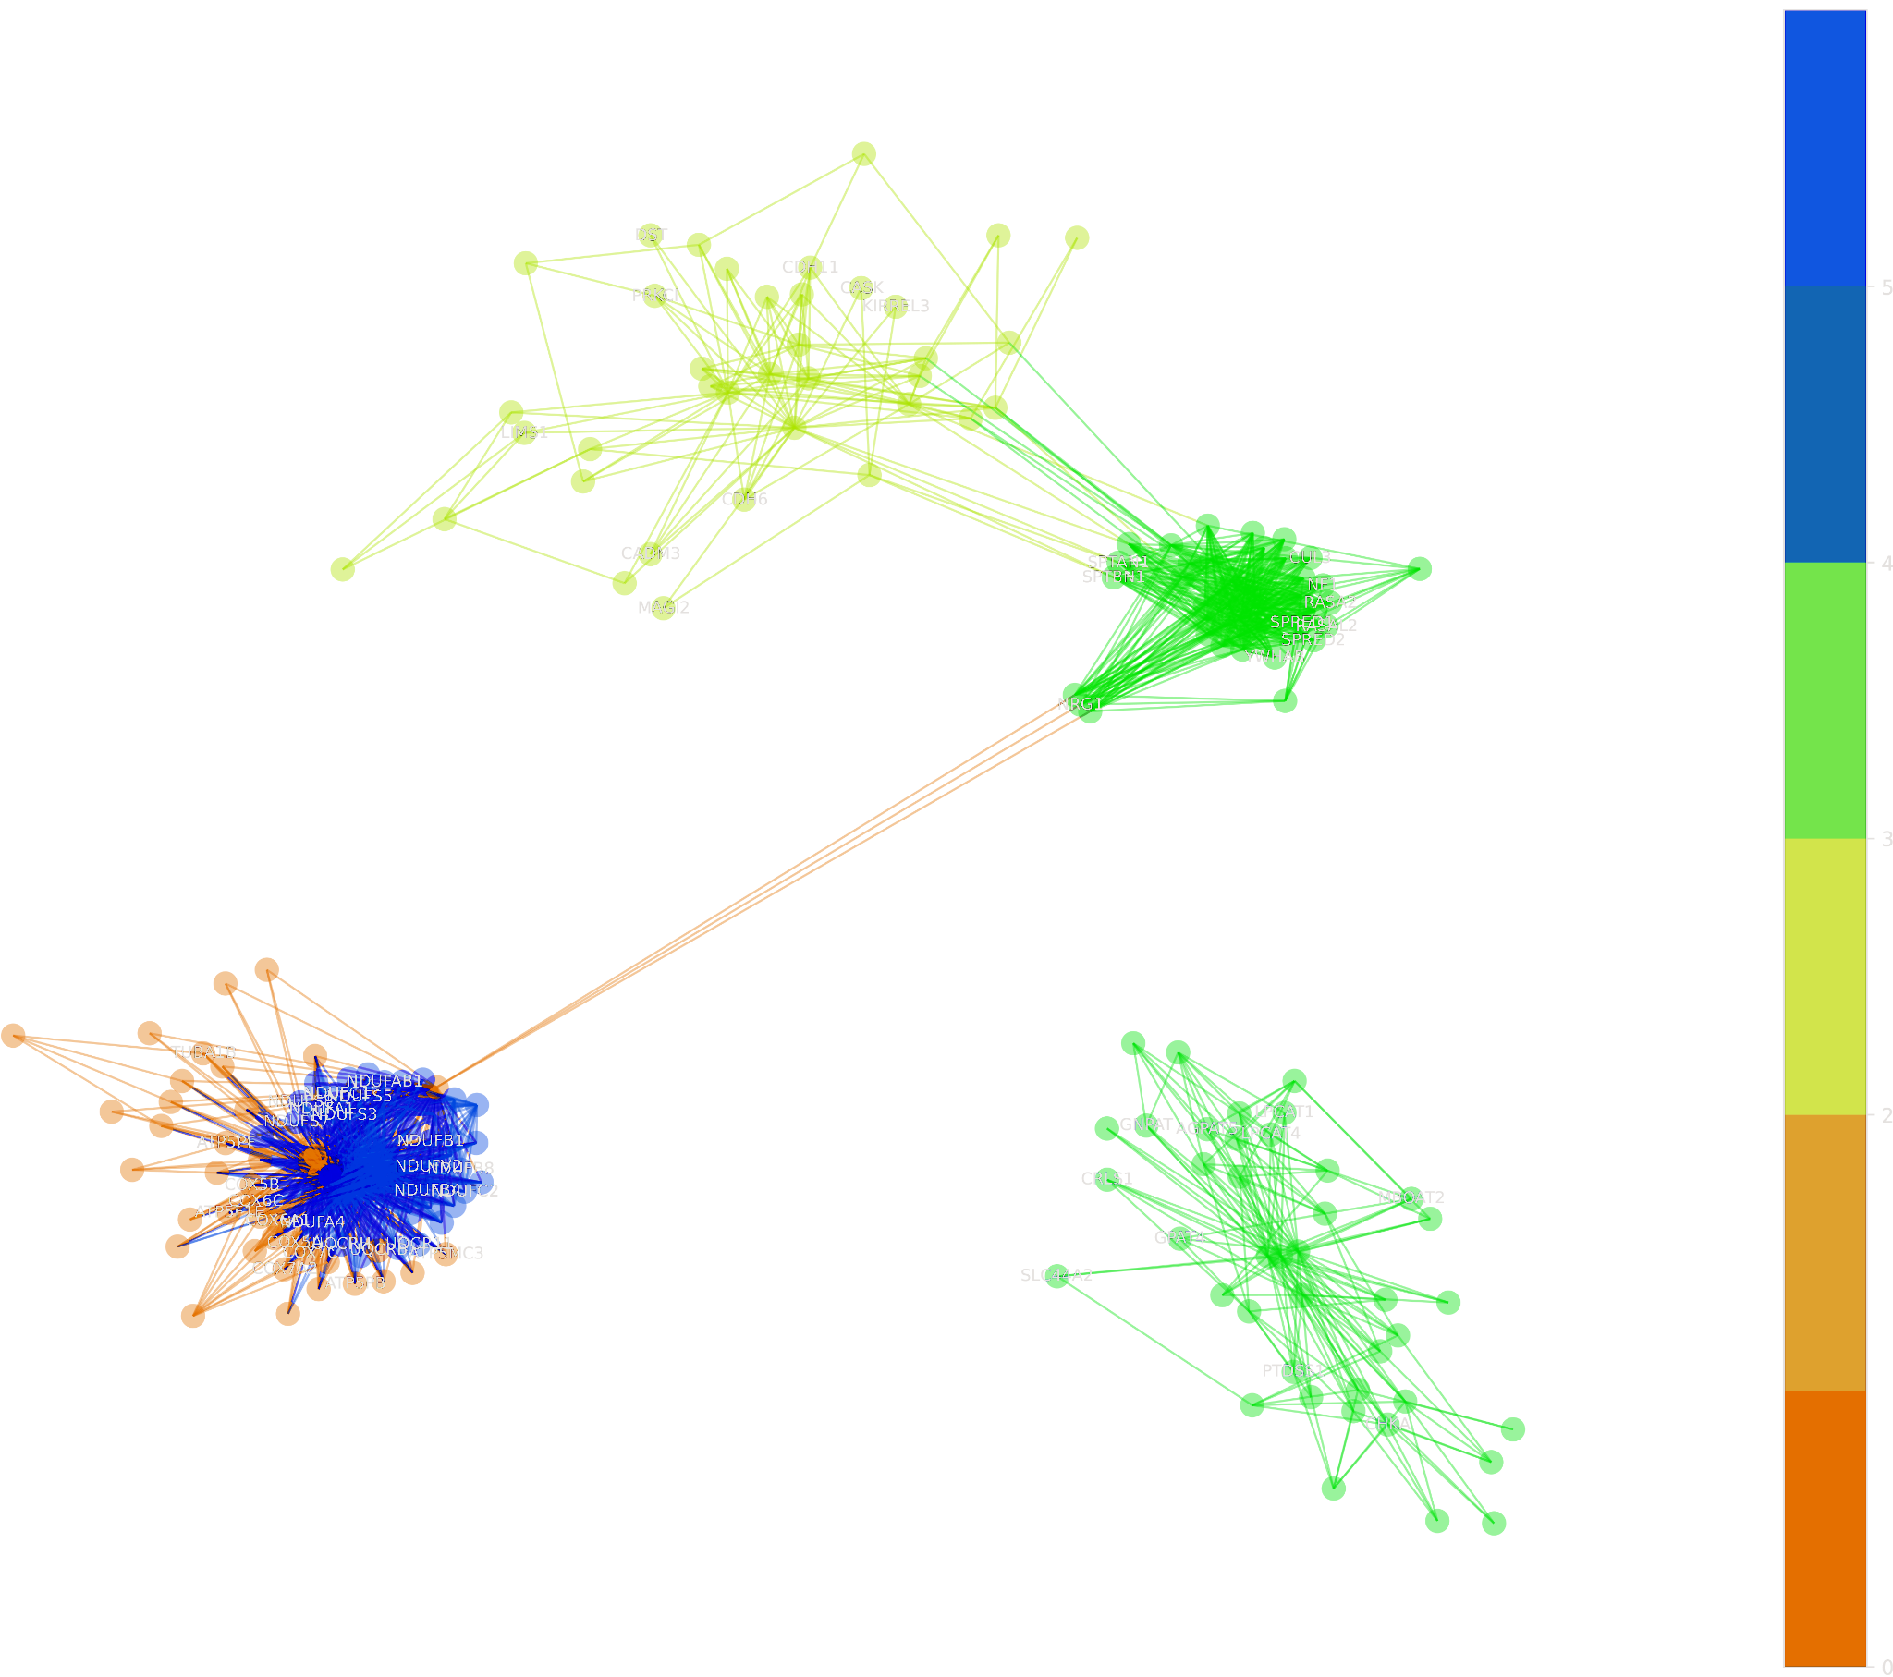
Fatty acid elongase knock-down mimics transcriptional effects of ABCA7 LoF
Transcriptional Overlap between ABCA7 LoF (Ex, brain) and ELOVL5 (NGN2)
mitochondrial gene clusters
CRISPRi targets

Slide 25
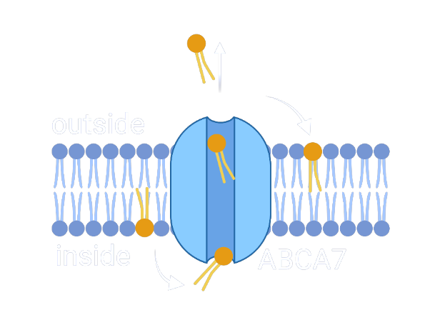
Does ABCA7 LoF induce high-risk cell states by disrupting the lipidome?
Observations
Model
Testing
haploinsufficiency in neurons
Lipid disruptions
ABCA7 KO
Mitochondrial dysfunction
DNA damage
*
Lipid disruptions
Altered mitochondrial function
DNA damage
Inflammatory signaling
Synaptic loss
Neurodegeneration
Lipid disruption upstream?
* Welch et al, SCIENCE ADVANCES, 2022

Slide 26



Acknowledgments
Thank you to the ROSMAP participants, their families, and the scientists and clinicians enabling the ROSMAP study - This research is not possible without you!
Rush Medical Center
David Bennett
Greg Klein
Ryan Johnson
University of Pittsburgh
Hansruedi Mathys
Madry Lab, MIT
Aleksander Madry
Guillaume Leclerc
Human Technopole, Milan
Jose Davila-Velderrain
Andrea Spitaleri
Generous Support From
Robert A. and Renee E. Belfer Family Foundation
The JPB Foundation
Carol and Gene Ludwig Family Foundation
Broshy & Halis Fellowships
NIA
Cure Alzheimer’s Fund
J. Crayton Pruitt Foundation Inc
Li-Huei Tsai, PhD
Shannon Wright, PhD
Postdoctoral Associate,
Tsai lab
Maeve Bonner, PhD
Previously: Tsai Lab
Current: Scientist,
Sanofi
Jenny Pao (Current: Sanofi)
Guillaume Leclerc (Madry Lab)
Adrian Jose Martinez (Tsai Lab)
Suella Menchaca (Tsai Lab)
Carles Boix (Harvard)
All Tsai Lab Members!
Thank you!

